Slide 1
Red Teaming analysis of the Breast Cancer Detector Model
Mikołaj Drzewiecki, Monika Michaluk

Slide 2
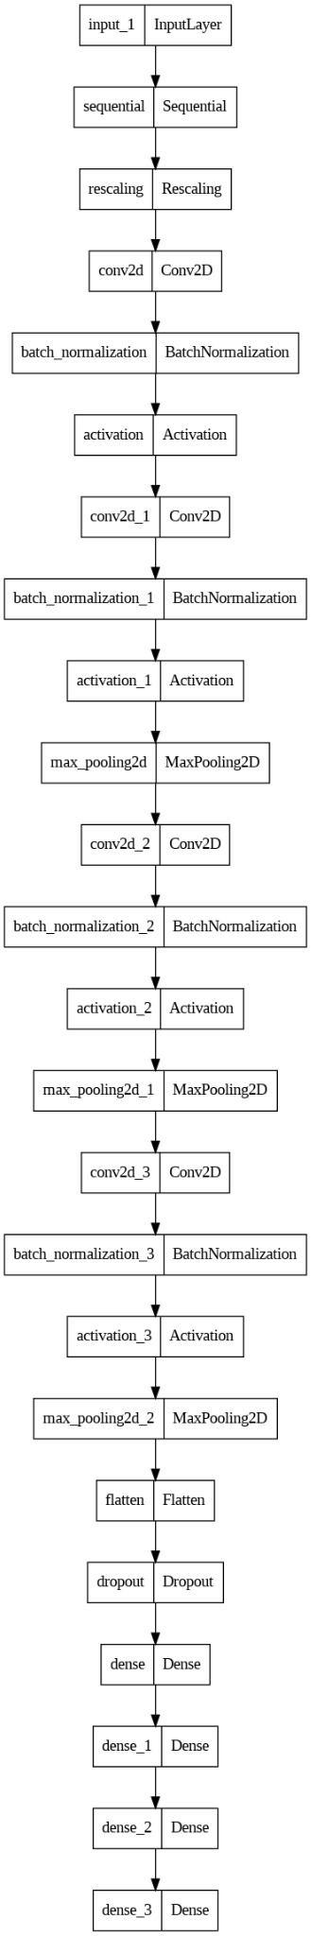
Model
published on Hugging Face
CNN architecture
detects Breast Cancer
authors state 87% accuracy on the test dataset

Slide 3
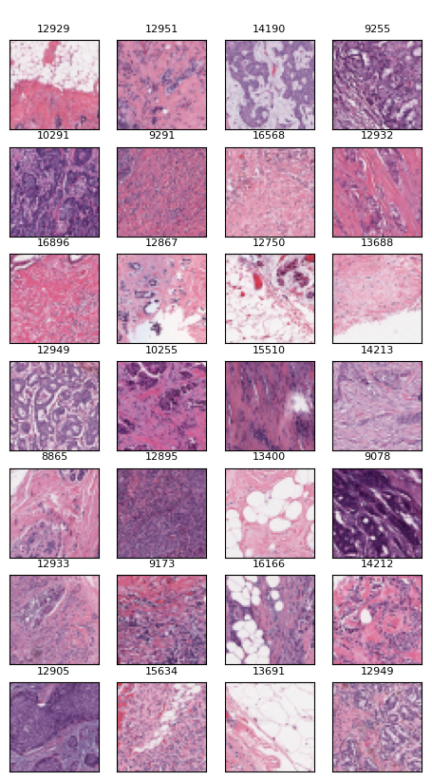
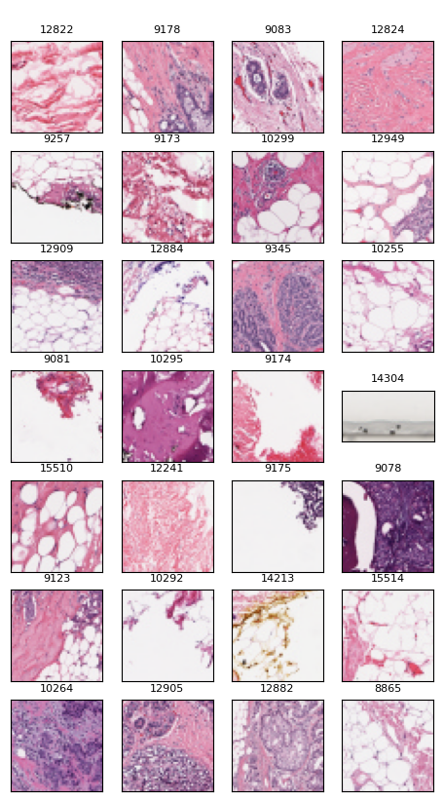
Dataset
Cancer tissues
Healthy tissues
277,524 RGB image patches measuring 50×50 pixels extracted from 162 breast cancer histopathology images scanned at a magnification of 40x.
Available on Kaggle
Images are labeled based on the presence of Invasive Ductal Carcinoma (IDC) features - the most common subtype of all breast cancers.
198,738 IDC negative and 78,786 IDC positive samples

Slide 4
Initial experiments results

Slide 5
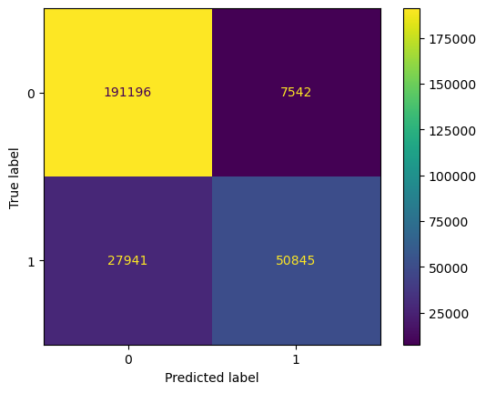
Evaluation of the model
Firstly, we verified that the model achieves 87% accuracy on the given dataset and we investigated further into predictions of the model:
There’s relatively high amount of positive samples (cancer) labeled as negative (healthy)

Slide 6
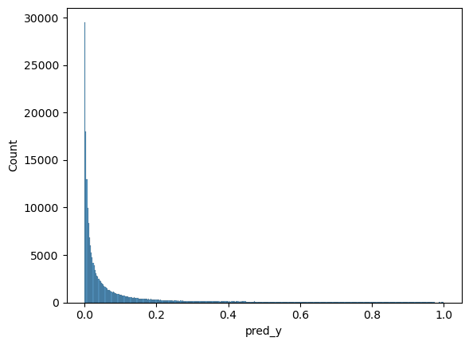
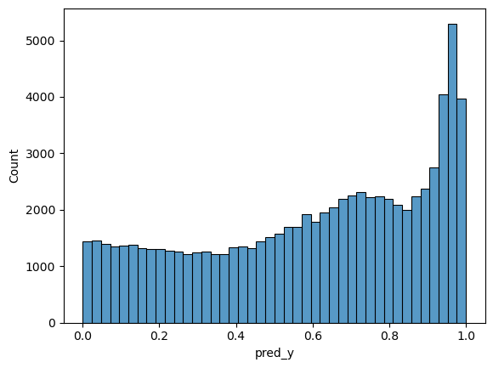
Evaluation of the model
Firstly, we verified that the model achieves 87% accuracy on the given dataset and we investigate further into predictions of the model:
There’s relatively high amount of positive samples (cancer) labeled as negative (healthy)
For negative samples the model is very certain about it’s answer and rather uncertain for positive samples.

Slide 7
Investigate easy and hard samples
This uncertainty may be caused by the class imbalance in the training dataset or may suggest that there are some problems concerning how the model makes it’s predictions.
To understand model’s predictions better, we visually investigated samples from each class and derived “corner-case” examples :
Wrong predictions for positive patches
Wrong predictions for negative patches
Uncertain predictions

Slide 8
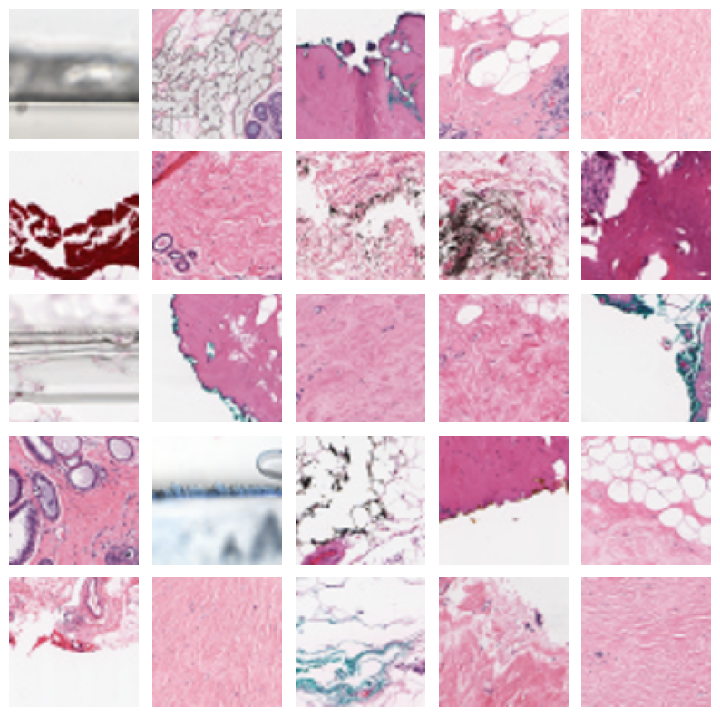
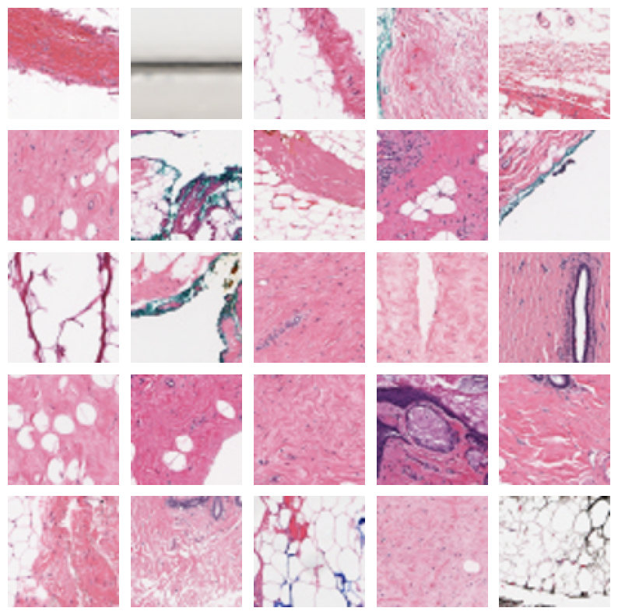
Healthy tissues, correct prediction
prediction = healthy, true label = healthy

Slide 9
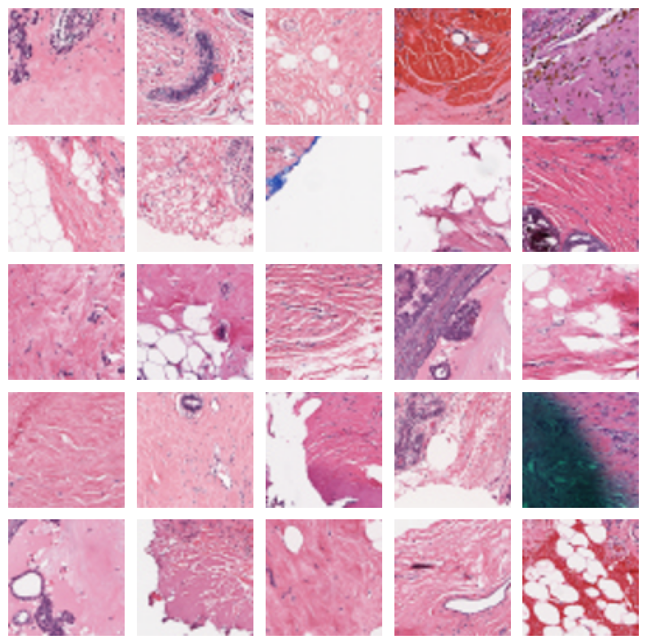
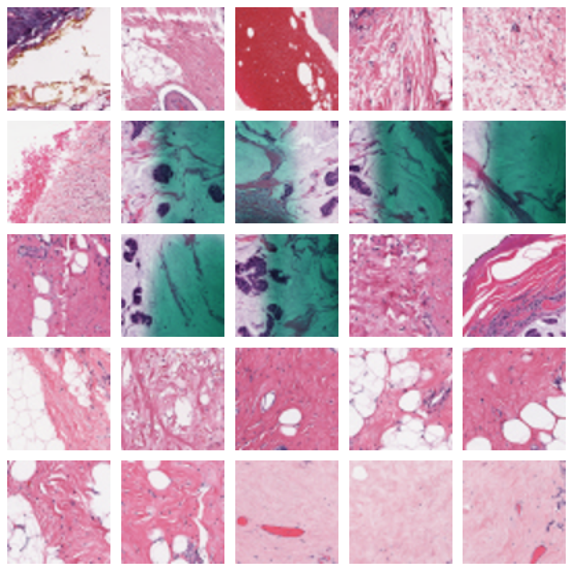
Cancer tissues, wrong prediction
prediction = healthy, true label = cancer

Slide 10
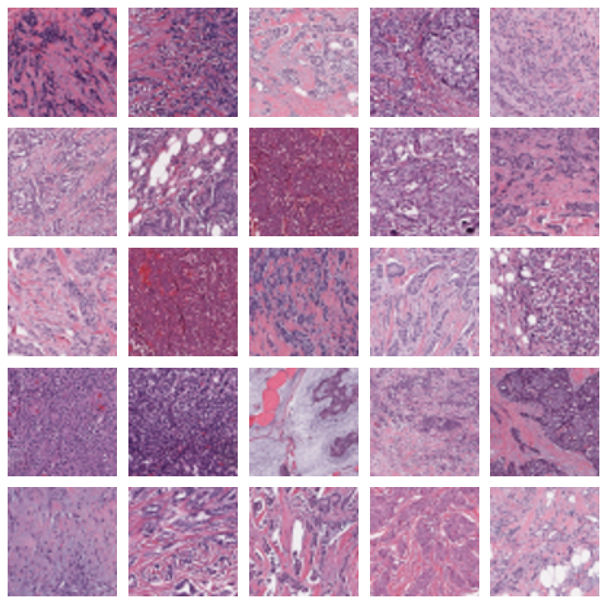
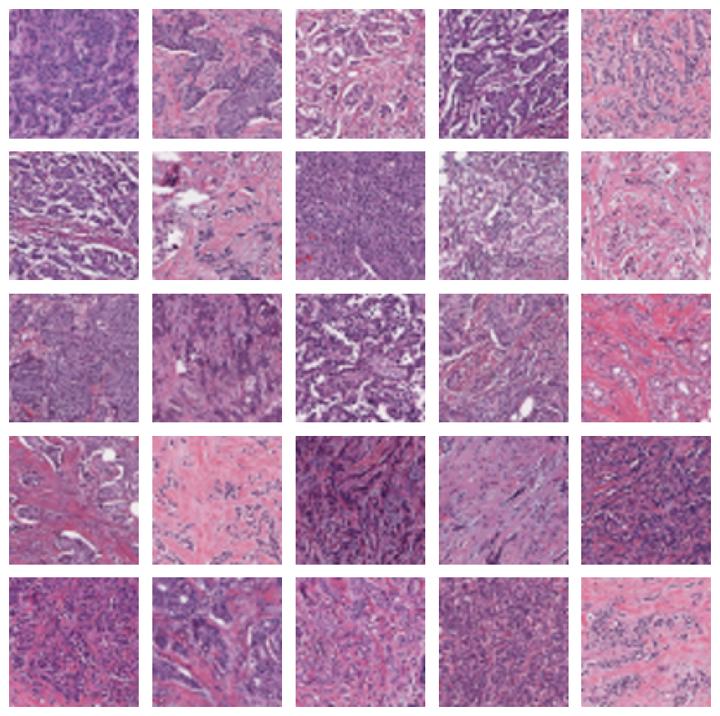
Cancer tissues, correct prediction
prediction = cancer, true label = cancer

Slide 11
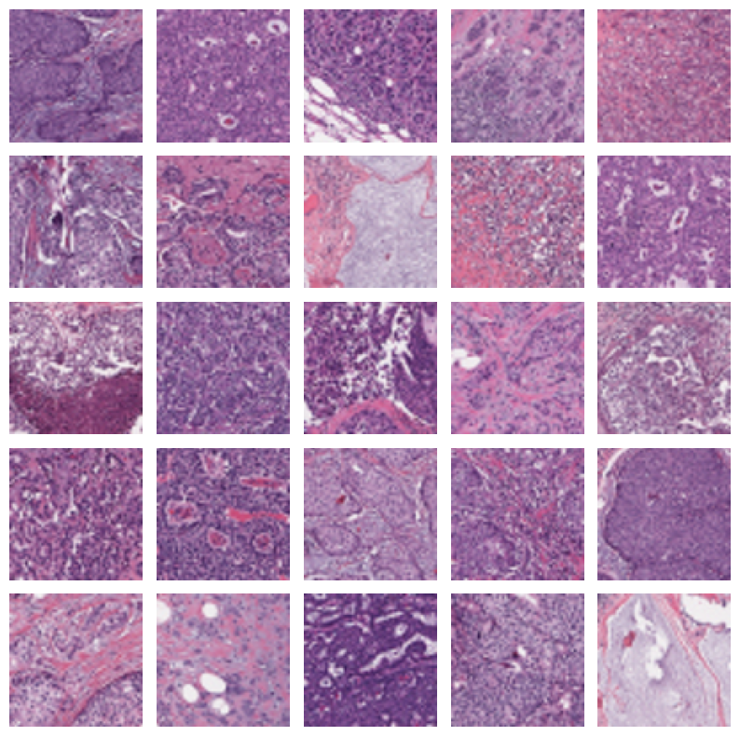
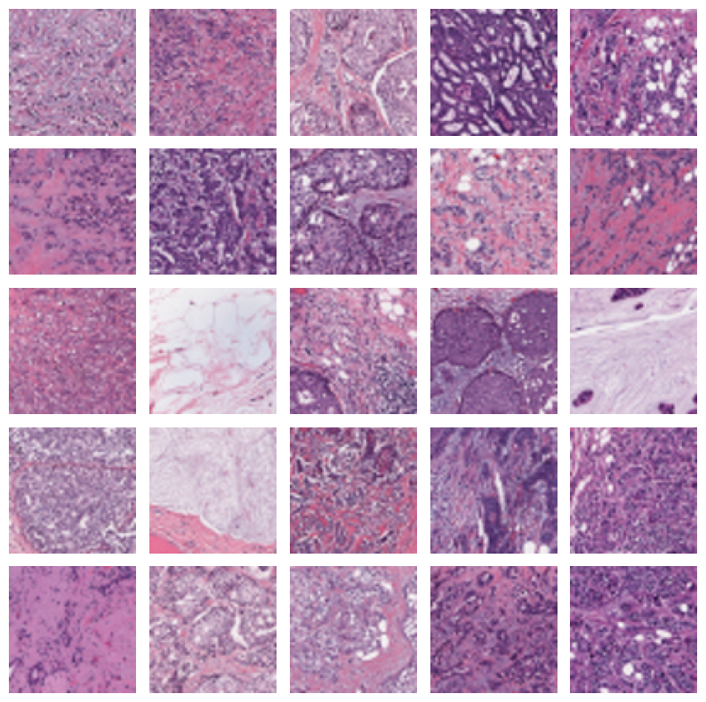
Healthy tissues, wrong prediction
prediction = cancer, true label = healthy

Slide 12
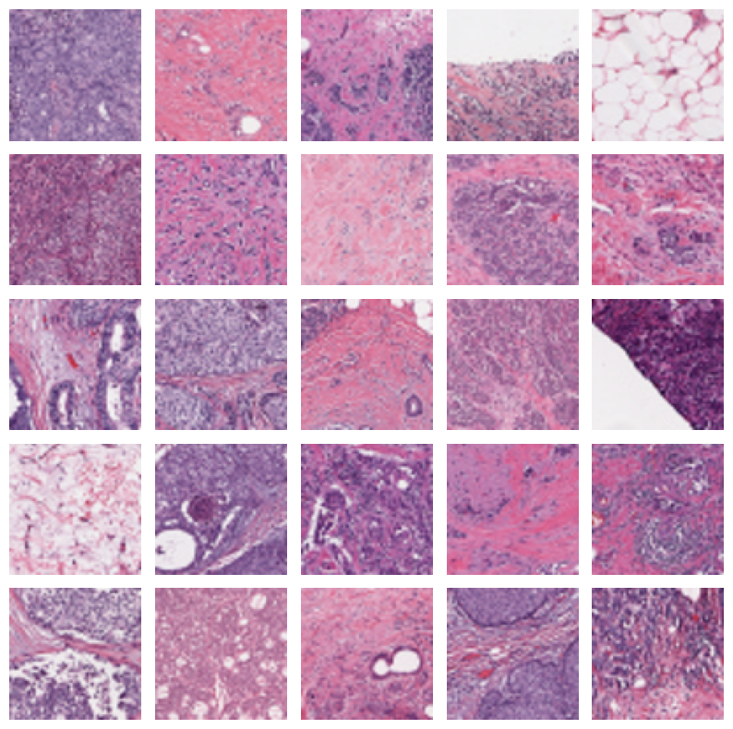
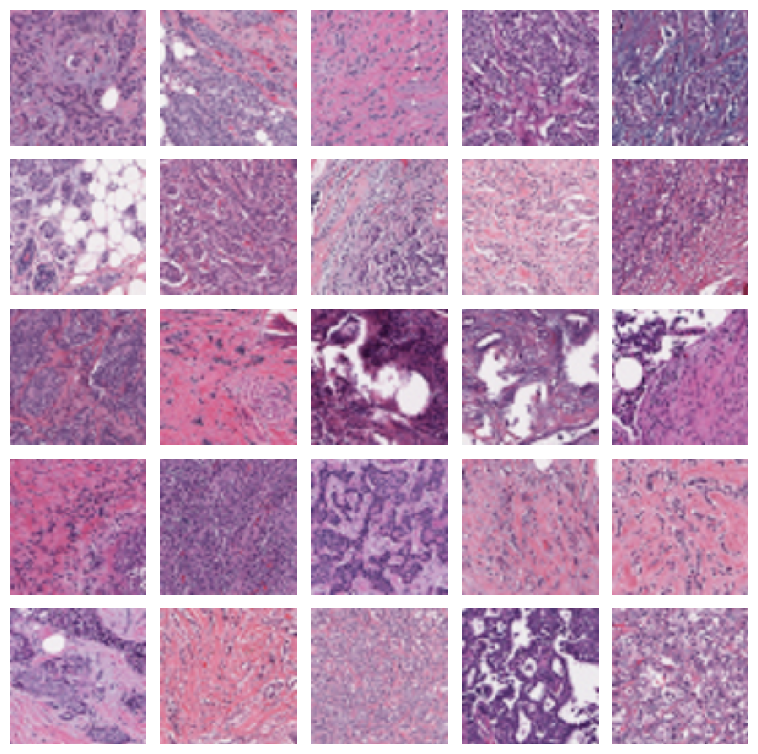
Uncertain, probability ≈ 0.5
healthy tissue
cancer tissue

Slide 13
Artifact Detected?
Hypothesis: The model learns that purple images (or at least those more faded and dim) depict cancer tissues.
Also the “coarse” structure of tissues seems to be related with positive answer of the model, but it’s presumably harder to verify.

Slide 14
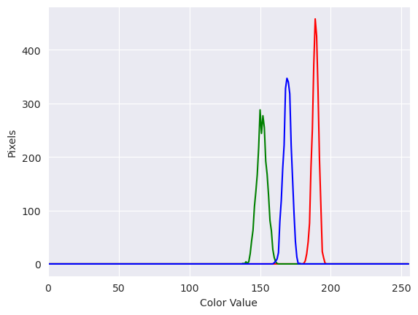
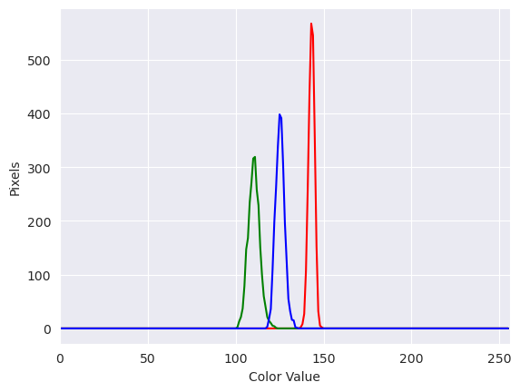
Color hypothesis - experiment
Averaged distribution of pixel values for 100 randomly selected patches of:
healthy tissues
tissues predicted as healthy

Slide 15
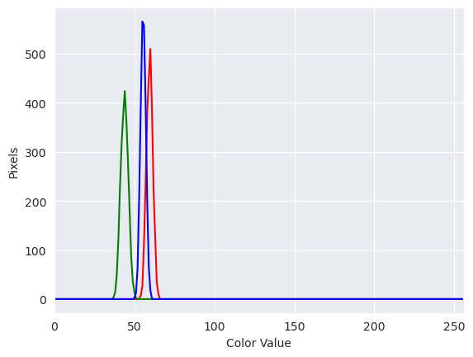
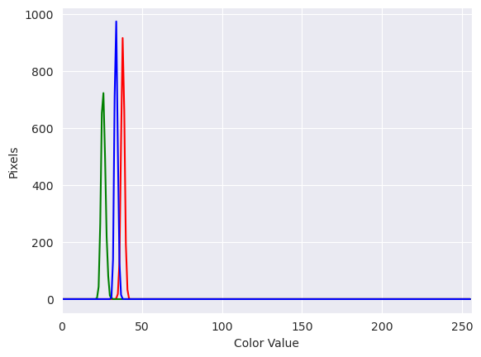
Color hypothesis - experiment
Averaged distribution of pixel values for 100 randomly selected patches of:
cancer tissues
tissues predicted as with cancer

Slide 16
Color hypothesis
This distributions seem to support the hypothesis that the model mostly looks at the color palette of the input image, but more formal tests can be done:
investigate more samples than only 100 randomly selected
compare colors in samples where the model makes mistakes or is uncertain
transfer color style from images of healthy tissues to the image of cancer tissues (or reverse) and check if the model’s prediction will change
generate adversarial random image with estimated colors distribution
divide full dataset into purple and not-purple images and check the model’s prediction
apply XAI feature attribution methods

Slide 17
Data perturbation
We also check model robustness to dataset perturbations:
convert images to grayscale
apply gaussian blur
adjust brightness
We test the model performance on randomly selected patches.

Slide 18
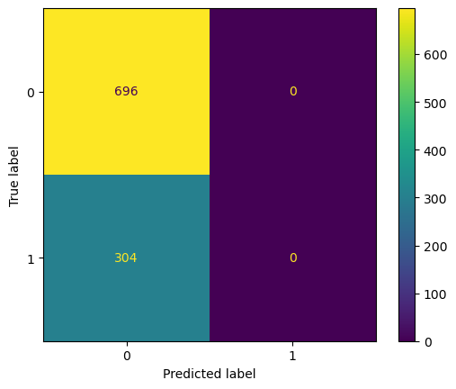
Data perturbation
Images converted to grayscale.
The model answers always predicts “no”.

Slide 19
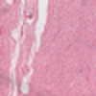
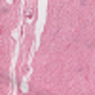
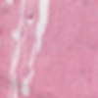
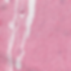
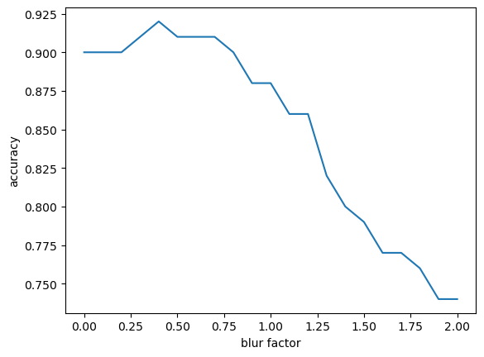
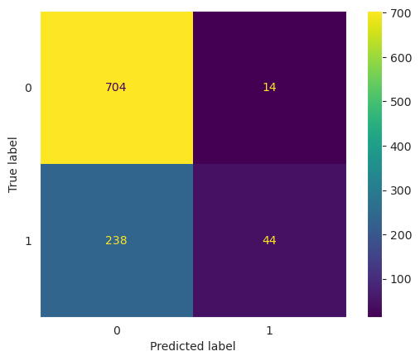
Data perturbation
Gaussian blur applied.
The model seem to be quite robust to such data perturbations.

Slide 20
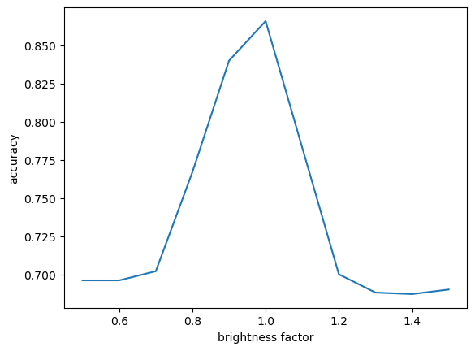
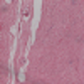

Data perturbation
Adjusted brightness.
The model’s performance drops significantly after changing brightness even a little.

Slide 21
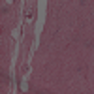
Data perturbation
Adjust brightness.
The model’s performance drops significantly after changing brightness even a little.
After darkening the image by 0.5 factor, the model again always predicts “no” for all examples.

Slide 22
Other datasets
Unfortunately, there are only a few datasets available on the Internet, which we could use to test the model. We required them to consist of samples significantly different from the training set and also - be sufficient enough to product sensible predictions with the model. Most of remaining datasets don’t contain annotation necessary for explainability, depict different types of cancer or have different resolution/magnification.
We marked the two which we found the most relevant:
[1] BreCaHAD - original dataset, from which the patches where extracted - contains annotations which parts of the image are related to cancer features, but has smaller resolution.
[2] BreakHis - doesn’t contain annotations, but contain images with magnification 40x, as the images the model was trained on. Still need a lot of preprocessing.
Notes:
https://www.nature.com/articles/s41597-020-00756-z

Slide 23
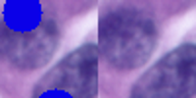
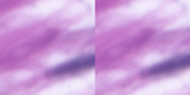
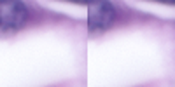
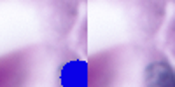
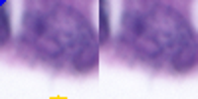
Out-of-Distribution Testing
p = 0.35
We evaluated the model on a few random patches extracted from the original dataset BreCaHAD dataset and compared the outputs with provided visual annotations by hand.
Differences from the dataset the model was trained on:
Patches are cropped at different, random places.
The images from the publicated BreCaHAD dataset seem to have worse resolution.
The model seems to perform quite well regardless, but again, more tests need to be done.
p = 0.0004
p = 0.05
p = 0.006
p = 0.42

Slide 24
Artifact detection
Direction for further experiments: feature attribution XAI techniques
Generate heatmaps or saliency maps to visualize which parts of the images influence the model's predictions.
Look for cases where the model relies on irrelevant artifacts or cues.
Problem: for explainability check we need the dataset with annotations which part of the image is related to cancer features.

Slide 25
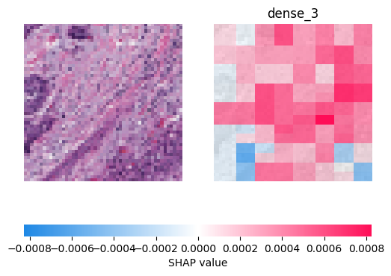
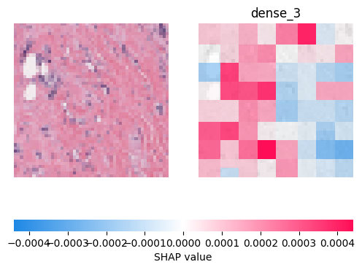
SHAP - initial results
We tried to verify the hypothesis of overwhelming influence of dimining
We selected samples which were labelled as false positive or false negative
Shap explanations seem to confirm for majority (or randomly selected) samples, the model was fooled by brightness (or at least it seem to contribute significantly)

Slide 26
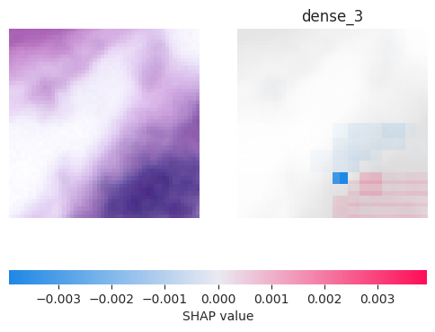

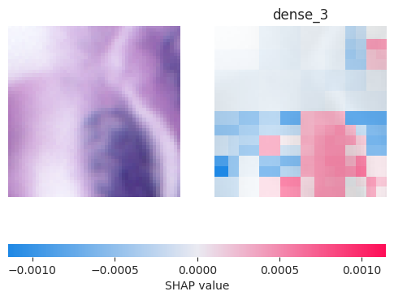

SHAP - comparison with annotated data
BreCaHAD dataset annotations ideally suffice to compare against shap explanations; it contain blue dots in places that should be take into consideration while determining the prediction.
We were able to come up with examples, which may support our hypothesis. The model almost always correctly spots significant part of an image. It turned out to be almost impossible to find a sample with ignored area of cancer. However, due to high brightness, the model sometimes associates those with little to no impact
prediction = 0.00586302
prediction = 0.02776008

Slide 27
Plan for further experiments
Formalize and verify findings of experiments conducted so far:
Check the color hypothesis
Perform more precise verification of the model’s behavior on other datasets
Evaluate feature importances and compare with annotated dataset.
Notes:
Unintended Memorization? Utilize techniques like activation maximization to understand which images from the training set highly influence the model's decisions. Investigate whether the model memorizes specific images.

Slide 28
Plan for further experiments
Dive deeper into the literature about explainability of the medical models.
One promising paper: Explainable Deep Learning Methods in Medical Image Classification: A Survey
Gives a lot of interesting ideas on applying XAI methods in medical diagnosis and how to assess the quality of the generated explanations:
Explanation by Feature Attribution (perturbation-based methods, saliency methods)
Explanation by Text (image captioning, concept attribution)
Explanation by Examples (case-based reasoning, counterfactual explanations, prototypes)
Explanation by Concepts

Slide 29
Thank you

